Slide 1
Directed Acyclic Graphs (Python) - Apache Spark
TEAM 7:
Daniel Morton, Akshay Phadke, Dylan Slack,
Monodeep Kar, Vinish Chamrani, Zeheng Chen

Slide 2
Problem: How to do Song Recommendation in Scale
Pandora’s Music Genome only has 800,000 songs identified.
Human curated, tagged.
It won’t scale.
Spotify: there are 30 millions songs.
We need a way to quickly analyze all the songs
This is a big data problem.
We will use Hadoop Spark

Slide 3
Song Recommendation
Based on the current song the user is listening to, recommend a set of similar songs based on various criteria such as Artist, Genre, etc.
Also if another user is listening to a similar song, then share the lists of songs heard among the users.
Based on the amount of hits the songs get, generate a list of popular songs and recommend most popular songs with higher priority.

Slide 4
Music Database
A collection of audio features and metadata for a million contemporary popular music tracks (http://labrosa.ee.columbia.edu/millionsong/)
Metadata for one million songs provided, sample audio for each can be fetched using other services, complementary datasets (e.g. user ratings) available
Sample Description:
Can use more detailed metadata to improve recommendation quality
title | string | song title
track id | string | Echo Nest track ID
track 7digitalid | int | ID from 7digital.com or -1
year | int | song release year from MusicBrainz or 0
bars start | array float | beginning of bars, usually on a beat
beats confidence | array float | confidence measure
beats start | array float | result of beat tracking
danceability | float | algorithmic estimation

Slide 5
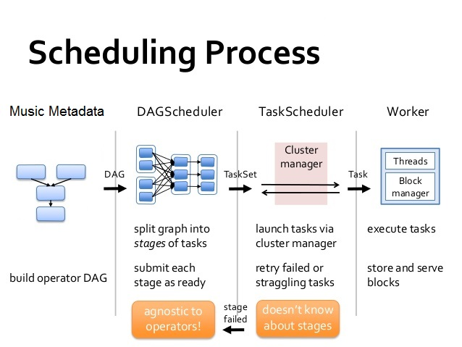
Implementation of DAG and Spark

Slide 6
Use Cases
Present the user with a category of songs or allow him to search for a specific song.
Once the song finishes, allow him to choose the next song from the same category or same artist.
Keep a track of the playlist and then compare the playlist with other users.
Exchange the most frequently heard songs as recommendations from other users.

Slide 7
Example Queries
GET /api/recommendations?songId=12
{
songs: [{
id: 14,
title: ‘A similar song’,
artist: ‘Some artist’
}, {
id: 352,
title: ‘Another similar song’,
artist: ‘Another artist’
}]
}

Slide 8
Timeline
Time | Component
3/26 - 4/2 | Define the problem, identify the dataset
4/2 - 4/9 | Finalize design, figure out Spark, begin implementation
4/9 - 4/21 | Implement design, create report and presentation
4/21 - 4/23 | CDR, submit project materials

